Slide 1
4.6 Multivariable Stochastic Calculus
報告者：陳政岳

Slide 2
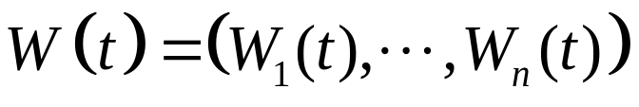
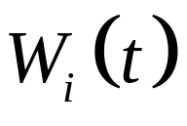

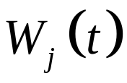



4.6.1 Multiple Brownian Motion
Definition 4.6.1. A d-dimensional Brownian motion is a
process with the following properties.
(1) Each is a one-dimensional Brownian motion.
(2) If , then the processes and are independent.
Associated with a d-dimensional Brownian motion, we
have a filtration F(t), , such that the following holds.
(3) (Information accumulates) For , every set in F(s) is also in F(t).
(4) (Adaptivity) For each , the random vector W(t) is F(t)-measurable.
(5) (independence of future increments) For , the vector of increments W(u)-W(t) is independent of F(t).

Slide 3
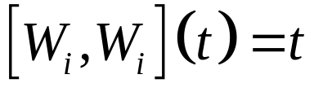
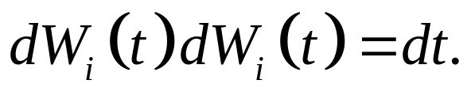

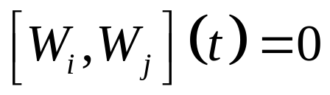
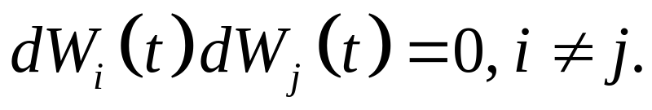
Each component of a d-dimension Brownian motion is a one-dimensional Brownian motion.
1. quadratic variation formula , and writing informally as
2. If , the independence of the and
implies and writing informally as

Slide 4
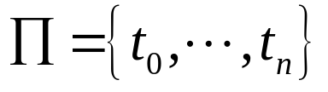


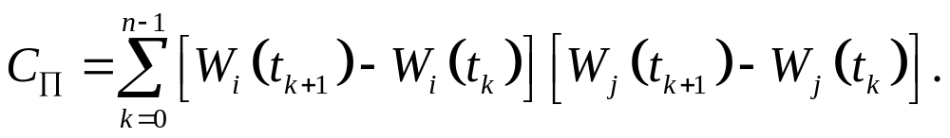
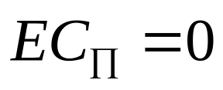
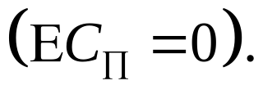
Let be a partition of [0,T]. For , define the sampled cross variation of and on [0,T] to be
Claim:
The increment are independent of one another and have mean zero

Slide 5
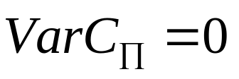
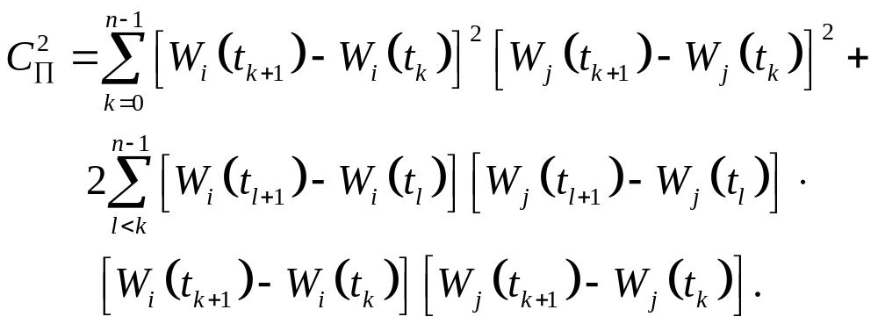
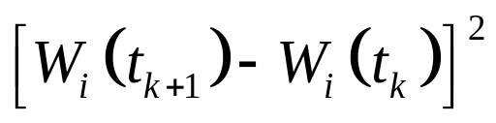
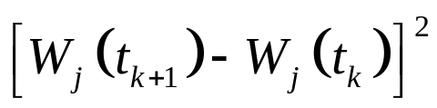
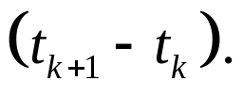
Claim:
The increments in the sum of cross-terms are independent of one another and all have mean zero. and are independent of one another and each has expectation

Slide 6
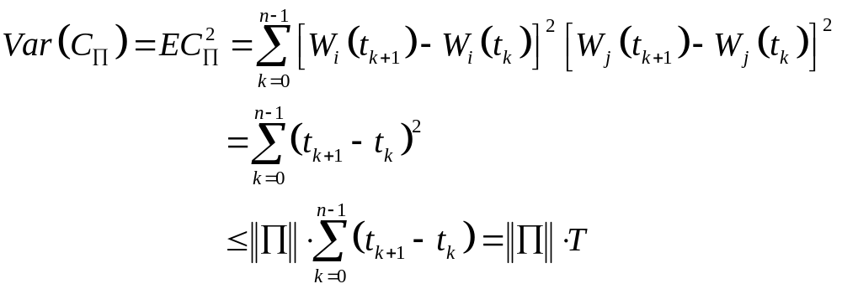
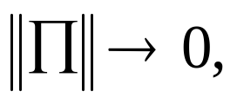
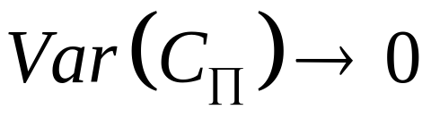
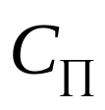
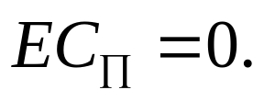
As we have , so converges to the constant

Slide 7
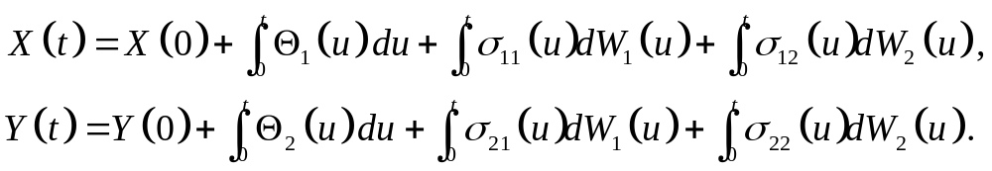
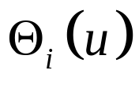
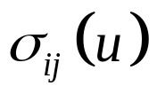
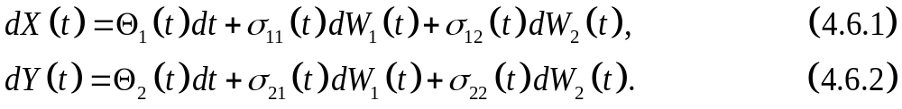
4.6.2 Ito-Doeblin Formula for Multiple Processes
Let X(t) and Y(t) be Ito processes, then
Assumed the integrands and are adapted processes. In differential notation,

Slide 8
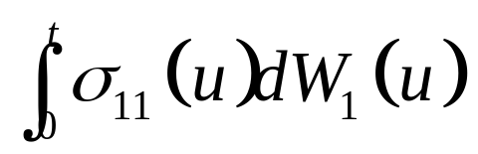
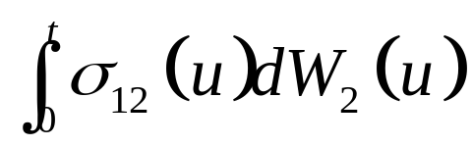
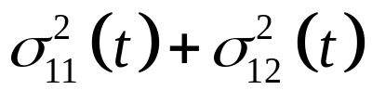
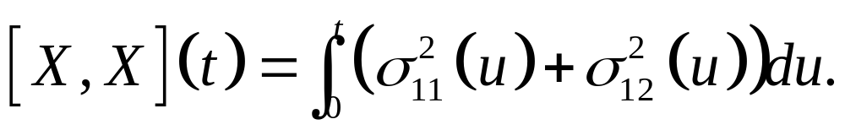
The Ito integral accumulates quadratic variation at rate per unit time.
In a similar way：the Ito integral
Because both of these integrals appear in X(t), the process X(t) accumulates quadratic variation at rate per unit time:

Slide 9
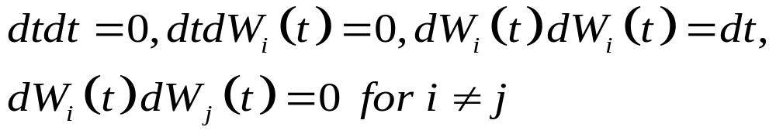
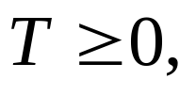
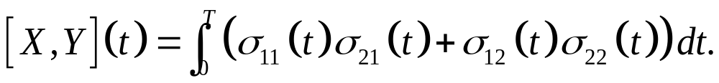
In differential form:
Using the multiplication rules
In a similar way,
Above equation says that, for every

Slide 10
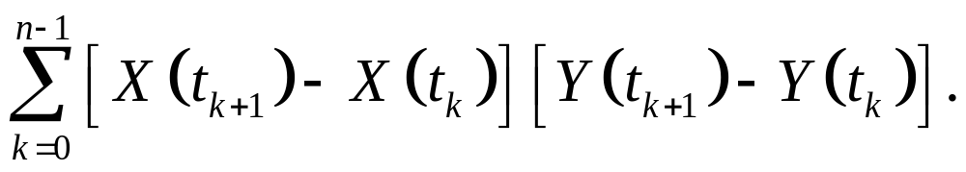
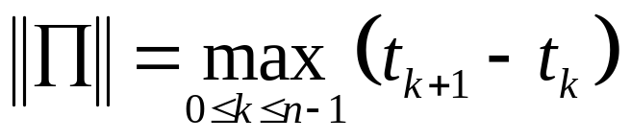
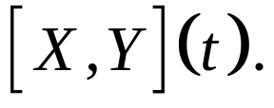
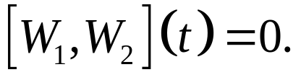
The term is defined as follow. Let
be a partition of [0,T] and set up the sampled
cross variation
When n go to infinity as the length of the longest subinterval goes to zero. This limit of the sum is
The proof is similar to the proof Lemma 4.4.4, with the additional feature

Slide 11
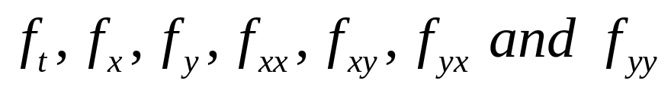
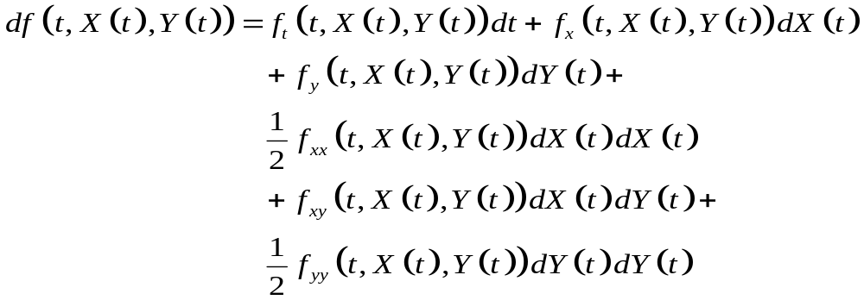
Theorem 4.6.2 (Two-dimensional Ito-Doeblin formula).
Let f(t,x,y) be a function whose partial derivatives
are defined and are continuous. Let X(t) and Y(t) be Ito processes as discussed above. The two-dimensional Ito-Doblen formula in differential form is

Slide 12
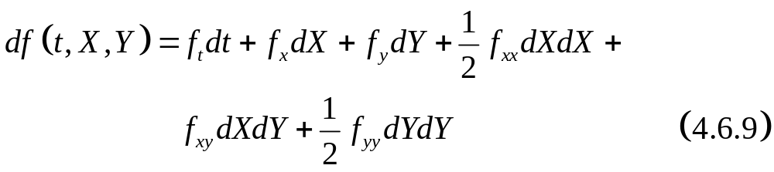
The proof of the theorem 4.6.2 is similar to that of theorem 4.4.6.
Rewrite above equation leaving out t. The compact notation :

Slide 13
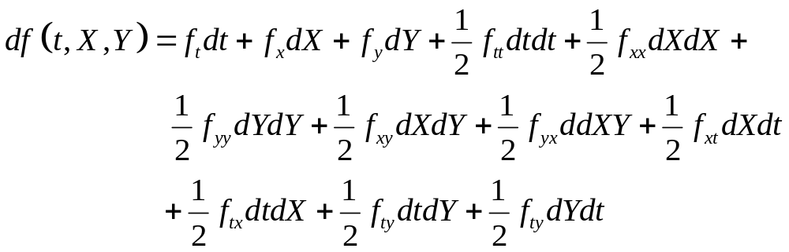
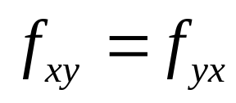
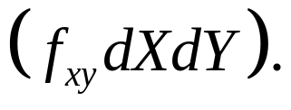
The right-hand side of the above the equation is the Taylor series expansion of f out second order. The full the Taylor series expansion:
But dtdt, dtdX, and dtdY are zero. The function f whose second partial derivatives exist and are continuous( ), and so we have combined these terms into the single term

Slide 14
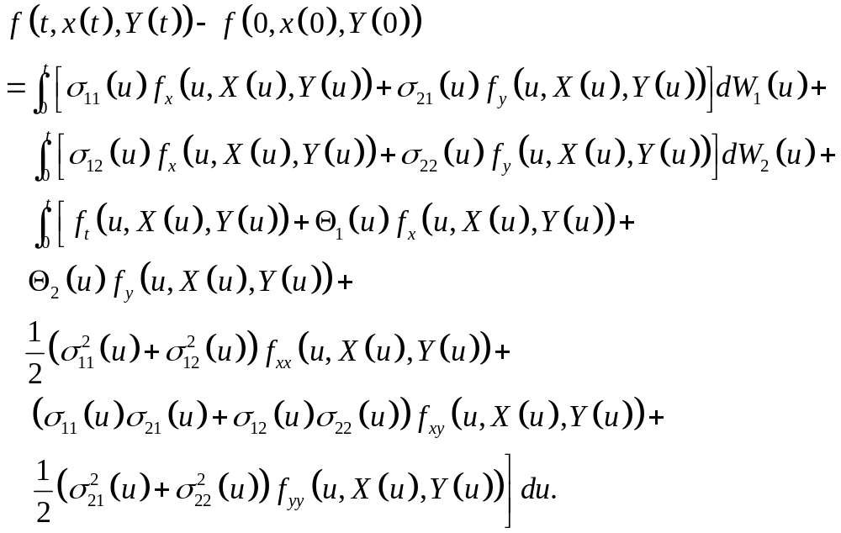
Making (4.6.1)-(4.6.5) substitution and then integration(4.6.9), we obtain the Ito-Doeblin formula in integral form:

Slide 15
The right-hand side of this equation has one ordinary (Lebesgue) integral with respect to du and two Ito integrals with respect to dW₁(u) and dW₂(u).

Slide 16
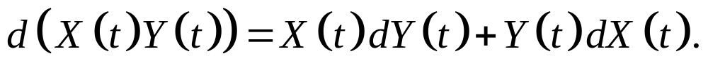
Corollary 4.6.3 (Ito product rule)
Let X(t) and Y(t) be Ito processes. Then
Proof:
Take f(t,x,y)=xy, so that f_{t}=0, f_{x}=y, f_{y}=x, f_{xx}=0, f_{xy}=1, and f_{yy}=0.
Cf. the chain rule:

Slide 17
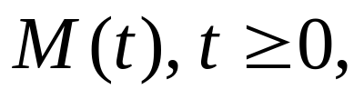
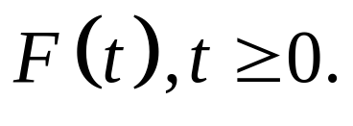

4.6.3 Recognizing a Brownian Motion
Theorem 4.6.4(Levy, one dimension)
Let be a martingale relative to a filtration Assume that M(0)=0, M(t) has continuous paths, and [M,M](t)=t for all
Then M(t) is a Brownian motion.

Slide 18
Idea of the proof: A Brownian motion is martingale whose increments are normally distributed. Levy’s theorem do not assume normality and in the conclusion is that M(t) is normality distributed.
The method used to establish normality is to first check that in the derivation of the Ito-Doeblin formula for Brownian motion , Theorem 4.4.1. Assumed quadratic variation [M,M](t)=t in this theorem is a continuous process.
Doeblin formula may be applied to M with the result that, for any function f(t,x) whose derivatives exist and are continuous.

Slide 19
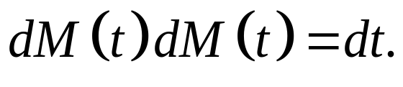
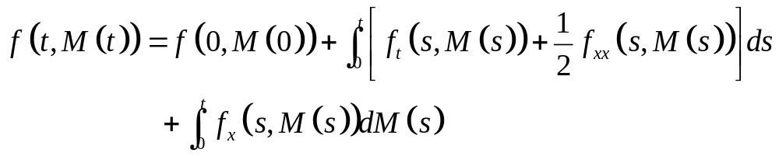
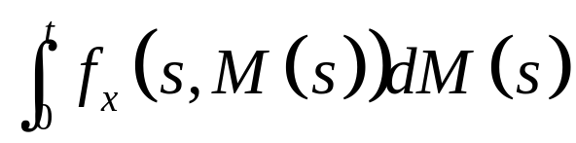
The last term uses
In integrated form,
Because M(t) is martingale, the stochastic integral is also. At t=0, this stochastic integral takes the value zero, so its expectation is zero.

Slide 20
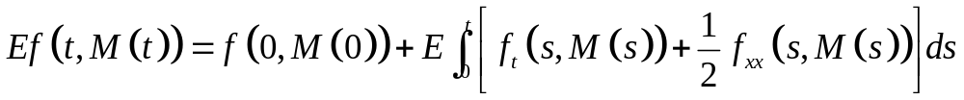



Define
Then
In particular,

Slide 21

This is the moment-generating function for the normal distribution with mean zero and variance t. M(t) is normality distribution.

Slide 22


Theorem 4.6.5(Levy, two dimension)
Let be a martingale relative to a filtration Assume that for i = 1,2, we have M_{i}(0)=0, M_{i}(t) has continuous paths, and [M_{i},M_{i}](t)=t for all If, in addition, [M₁,M₂](t)=0 for all then M₁(t) and M₂(t) are independence Brownian motions.

Slide 23

Idea of the proof: The Theorem 4.6.4 implies that M₁ and M₂ are Brownian motions.
Claim: independence
Let f(t,x,y) be a derivative and continuous function. The two-dimension Ito-Doblin formula implies that

Slide 24


where assumption,
Integration

Slide 25


The last two terms on the right-hand side are martingale, starting at zero at time zero, and expectation zero.
Define

Slide 26


Then
In particular,

Slide 27
The joint moment-generating function factors into the product of moment-generating functions, M₁ and M₂ must be independence.

Slide 28




Example 4.6.4(Correlated stock prices)
Suppose
Where W₁(t) and W₂(t) are independent Brownian motion and and are constant. To analysis the stock price S₂ process, we define
W₃(t) is a continuous martingale with W₃(0) = 0.

Slide 29




By one-dimension Levy Theorem, Theorem4.6.4, W₃(t) is a Brownian motion.
The differential of S₂(t) as is a geometric Brownian motion with mean rate of return and volatility

Slide 30





The Brownian motion W₁(t) and W₃(t) are correlated. According to Ito’ product rule,
Integrating,
The Ito integrals have expectation zero, so the covariance of W₁(t) and W₃(t) is Because W₁(t) and W₃(t) have standard deviation , the number is the correlation between W₁(t) and W₃(t).

